Slide 1
NUera
NUera is a learning platform designed to provide educators, administrators and learners.
It is a service-oriented architecture (SOA) based application.
It is a platform where students can learn new skills, by enrolling in different courses created by experts.

Slide 2
Project Scope
There are different micro services running at the backend.
Service 1: User Management (Login/Registration/User Data /Course Enrollment)
Service 2: Course Creation/Updation /GET/Delete (Videos, Textual data, Links)
Service 3: Forum / Discussion
Service 4: Database Caching.

Slide 3
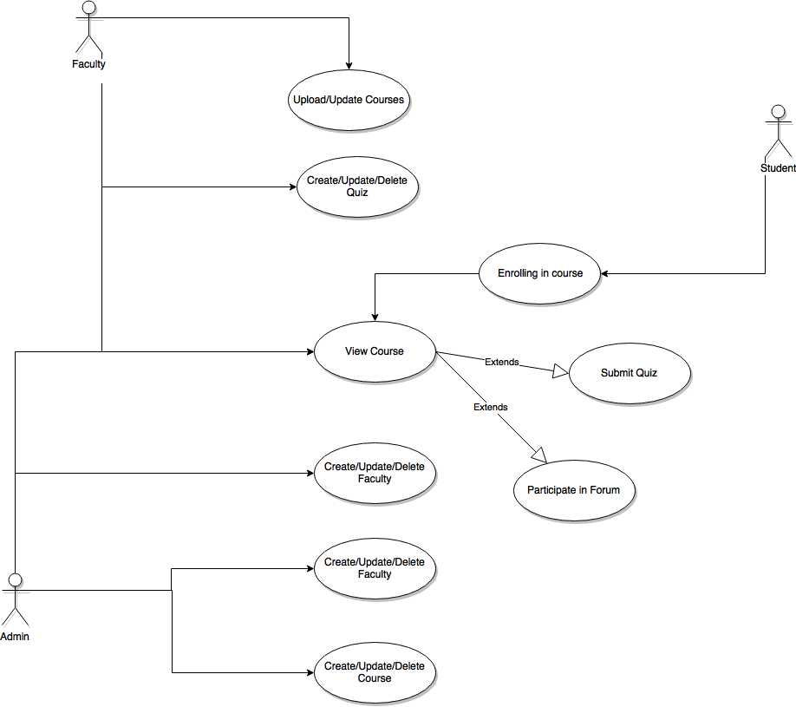
Project Use Case

Slide 4
Project Team Detail with Roles and Responsibility:
Name | Email Id | Enrollment | Number | Role
Priyanshu Bhatnagar | Priyanshu.bhatnagar@st.niituniversity.in | U101114FCS107 | 7737832939 | Frontend & Backend
Sriram Arvind L. | Lsriram.arvind@st.niituniversity.in | U101114FCS082 | 7023065645 | Database
Rashika Bhargava | Rashika.bhargava@st.niituniversity.in | U101114FCS188 | 7023695530 | Frontend
Raghav Mittal | Raghav.mittal@st.niituniversity.in | U101114FCS111 | 8700608171 | Backend
Rajdeep Mukherjee | Rajdeep.mukherjee@st.niituniversity.in | U101114FCS115 | 9163849432 | Backend
Nikhita Agarwal | Nikhita.agarwal@st.niituniversity.in | U101114FCS101 | 9704538002 | Backend

Slide 5
Technical detail of project.
Language to be used for project: Python, HTML, CSS, JavaScript.
Database to be used for the project: MySQL
Third party API Detail: TBA
Tools to be used: Pycharm, Visual Studio Code, MySQL Workbench, Emacs.

